Slide 1



Who wants a glass of wine ?
Let’s convert a virtual No to Yes!

Slide 2


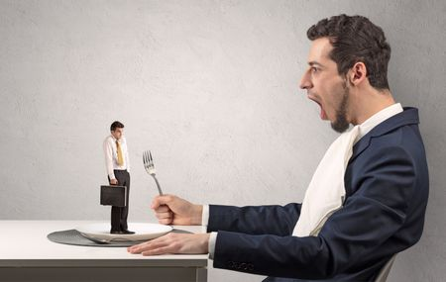
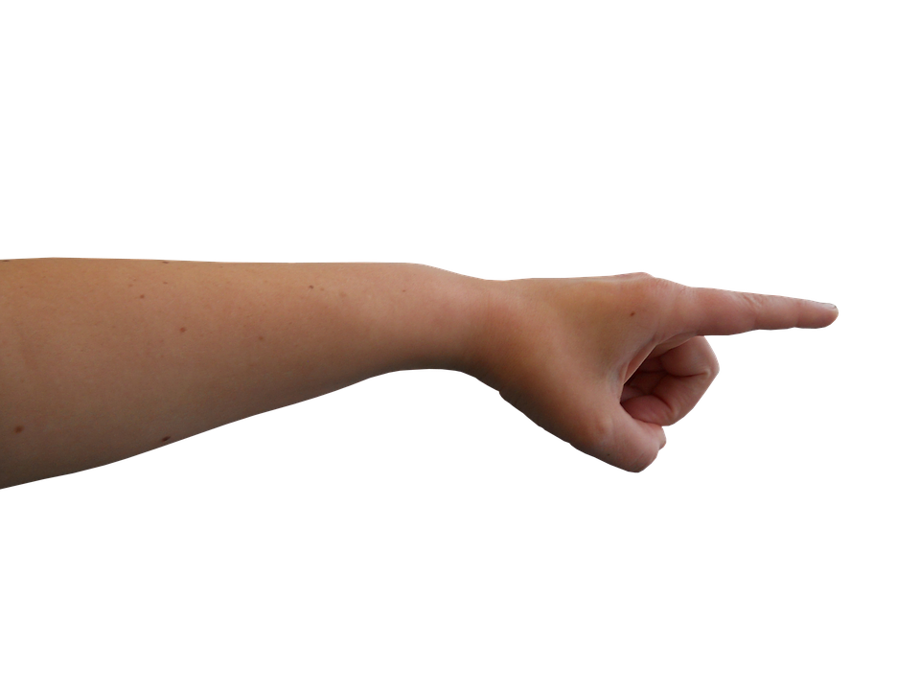
Australian wine industry Recap
The Big guy 70%
You 5?

Slide 3
Australian wine industry recap (continue)
Customer wanting to support local winemakers drives an increase in value
Volume of sales changed due to restricted options to buy in store
Over 70% of global online alcohol sales are from mobile devices
E-commerce costs can range from $10k - $250k or more

Slide 4

Business question
How can we convert more sales online?

Slide 5
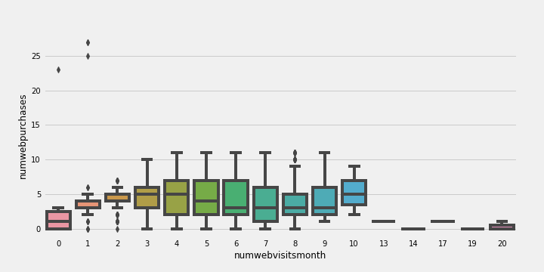
Online activity overview
Number of web visit per month & Number of web purchase
76% Conversion rate

Slide 6
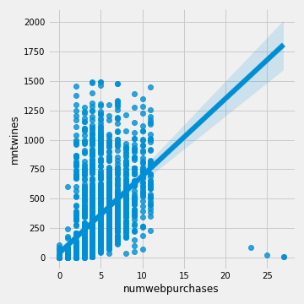
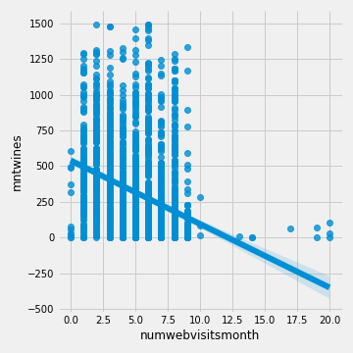
Online activity overview
Web purchase, Web visit, and amount spend on wines
Average of $74 per web purchase with average of 5 visits per month

Slide 7
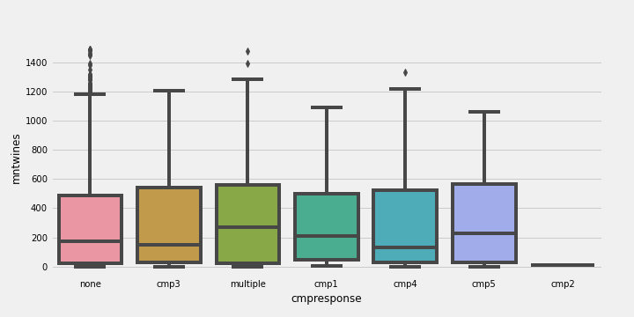
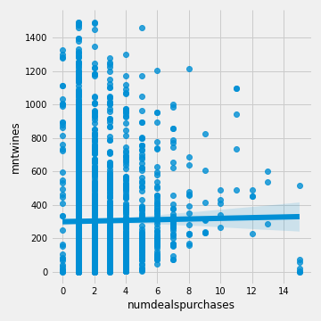
Online activity overview
Response to campaign & amount spend on wines
Wines & Deal purchase
Customer who has no response to campaign has potential to spend more on wines

Slide 8
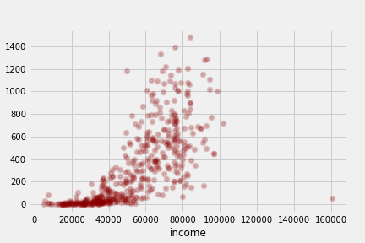
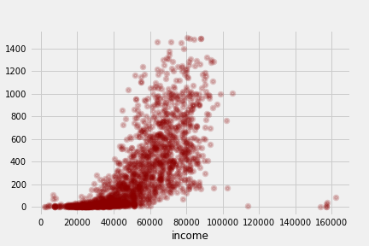
Response vs no response: Income
Response
No response
Majority of customer in Response group earn less than No response

Slide 9
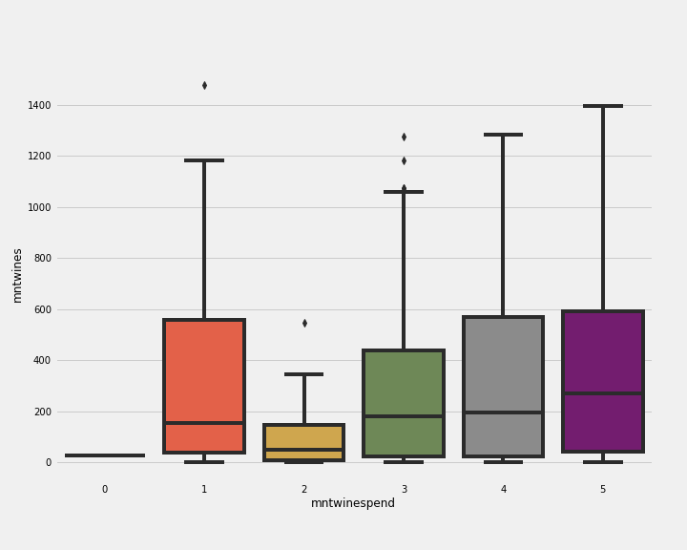
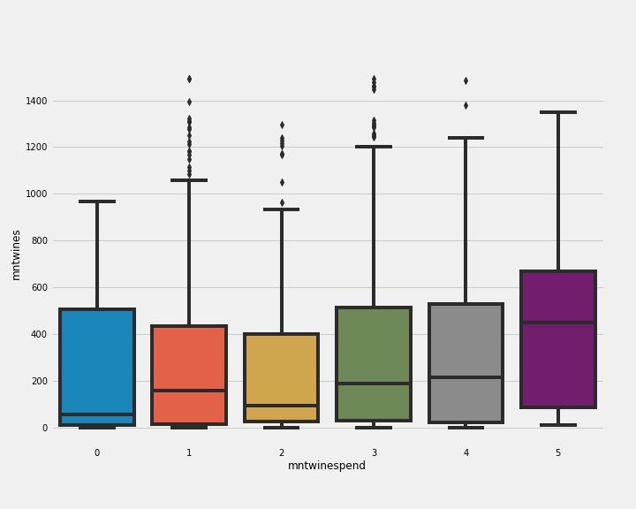
Response vs no response: Amount spend on wines
Response
No response
Customer in No response group spends more on wines

Slide 10
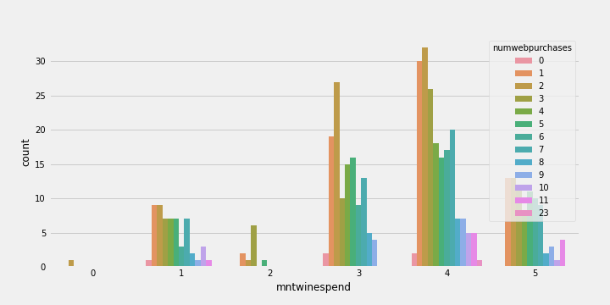
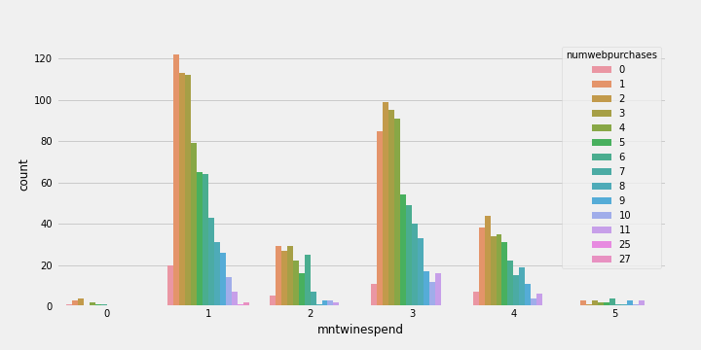
Response vs no response: Web purchase
Response
No response
Customers who respond to campaign tend to spend more on wines.
However, customer in No response group has potential to spend more if we can convert them

Slide 11
Dataset overview for modelling
Dataset split
20% Unseen set
80% Train and test set
Target: Response
Top 5 from SelectKBest features are
Recency
Amount spend on wines
Amount spend on meat products
Age
Group of amount spend on wines(added feature)
*We will also compare results using 13 selected features

Slide 12
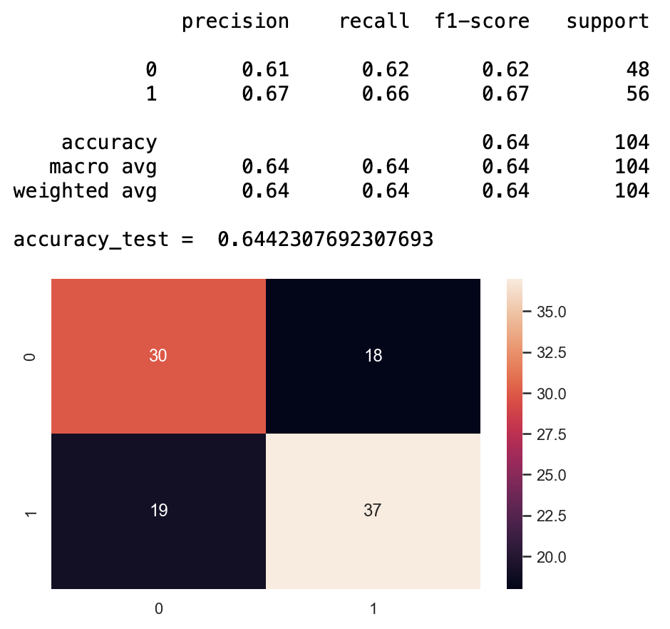
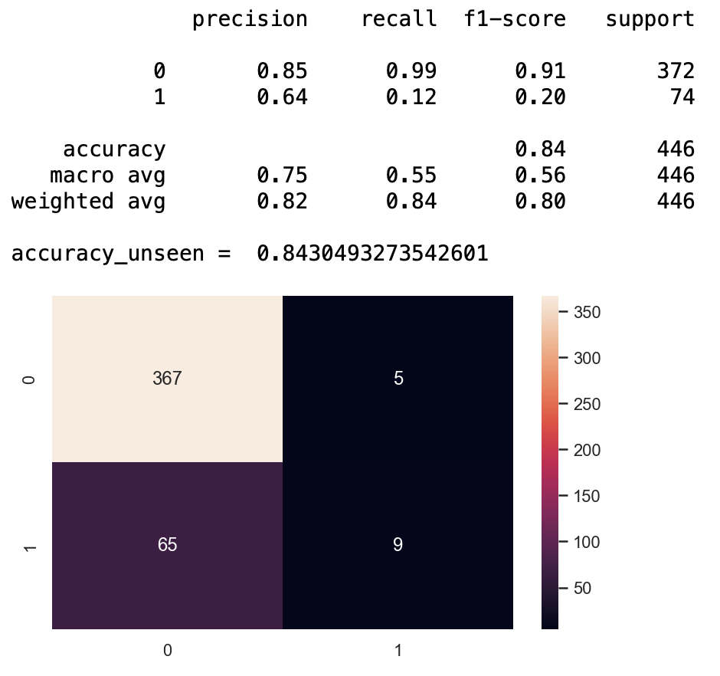
Model results: Logistic Regression
Test set
Unseen set

Slide 13
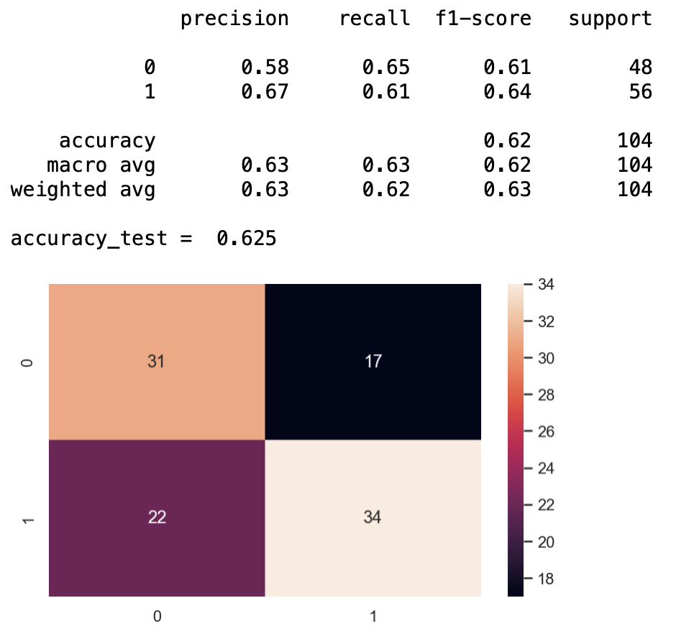
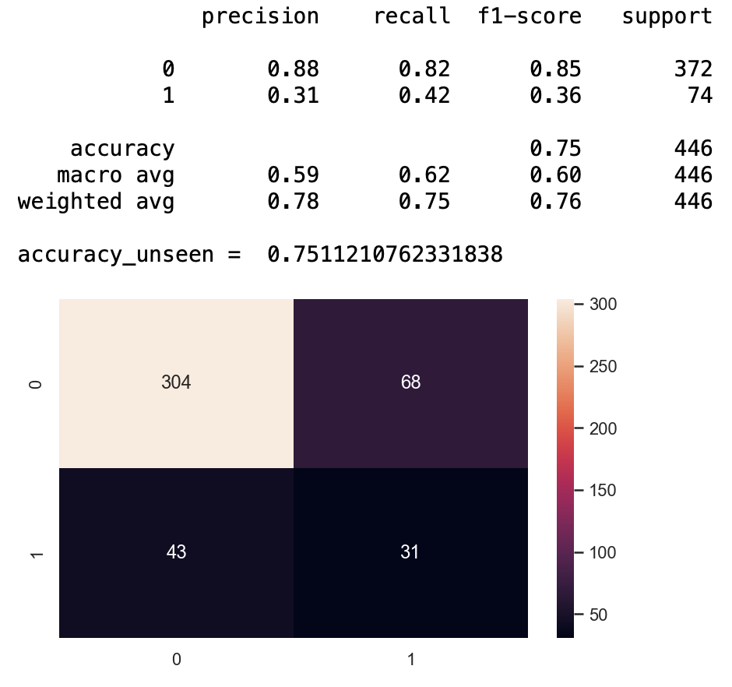
Model results: Support vector machine
Test set
Unseen set

Slide 14
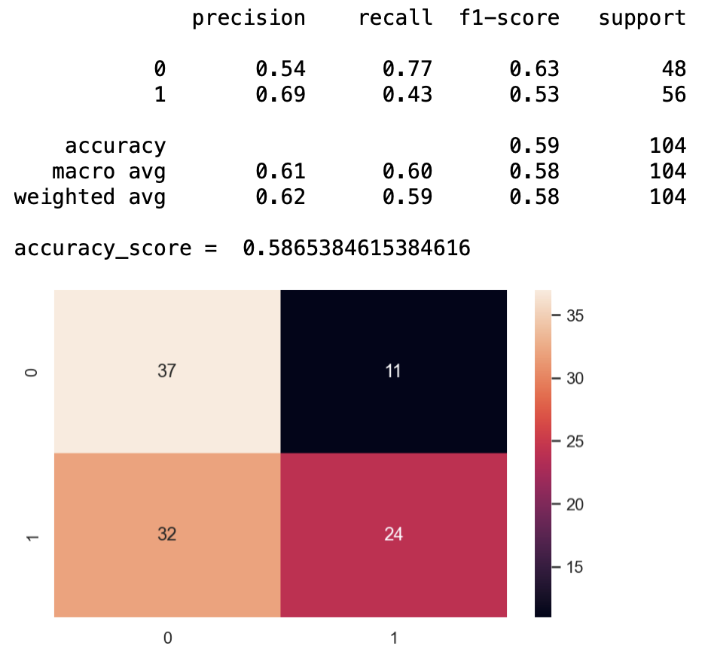
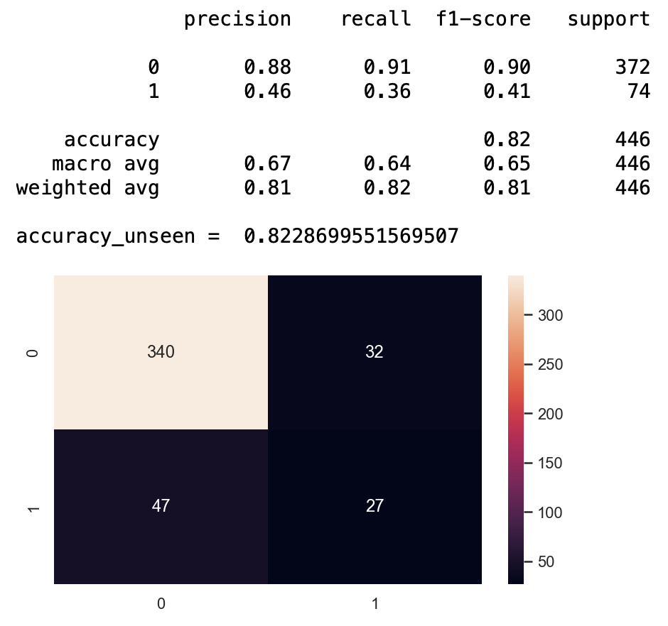
Model results: gaussian naïve bayes
Test set
Unseen set

Slide 15
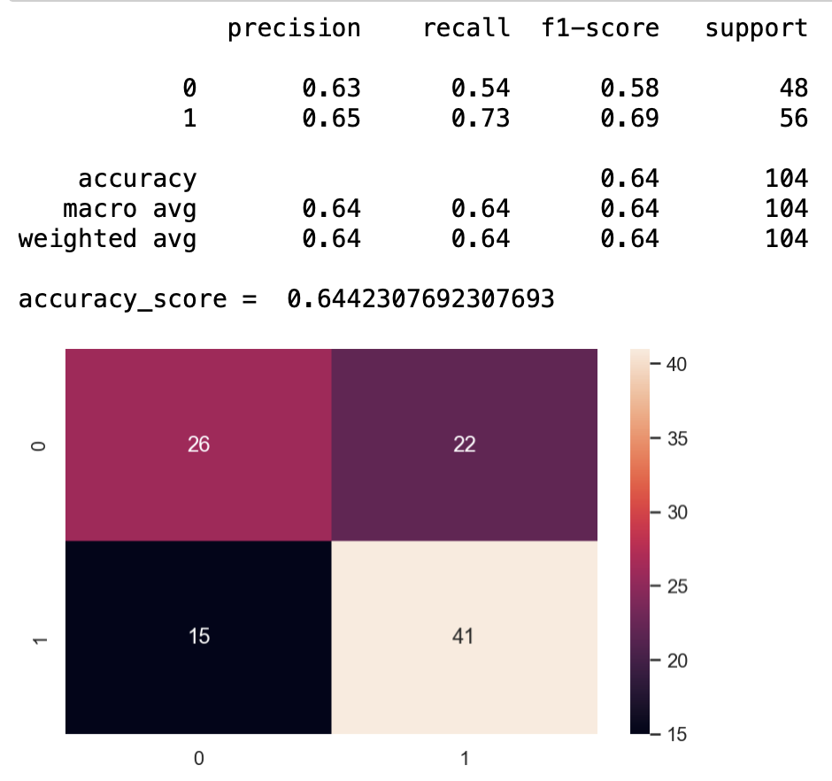
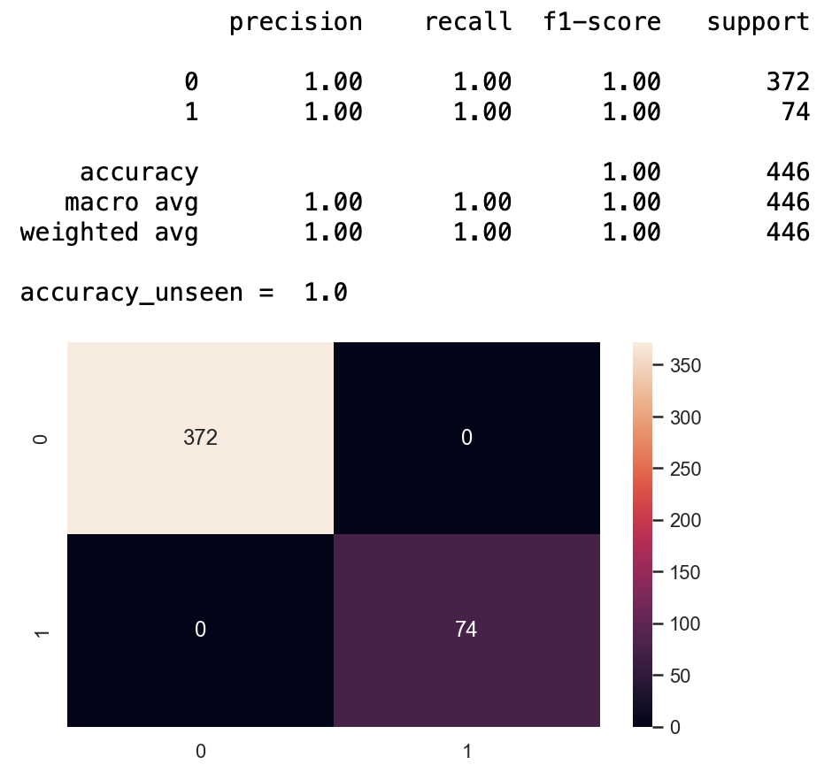
Model results: random forest
Test set
Unseen set

Slide 16
Model results: Summary
Random Forest performs the best when using as many as 13 features or as little as 5 features.
So Random Forest is our chosen model for deployment

Slide 17
Summary & What’s next?
Online shop has a positive impact on the amount customers spend on wines
Higher educated group of customer are happy to spend more on wines
Next step
Developing a model to identify what type of marketing campaign create the most impact to the conversion rate of the sale of wines

Slide 18
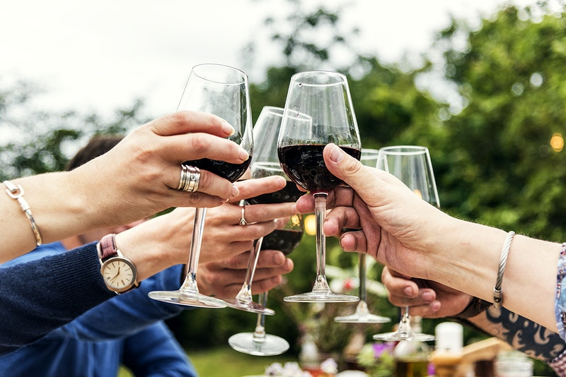
Question ?

